Slide 1
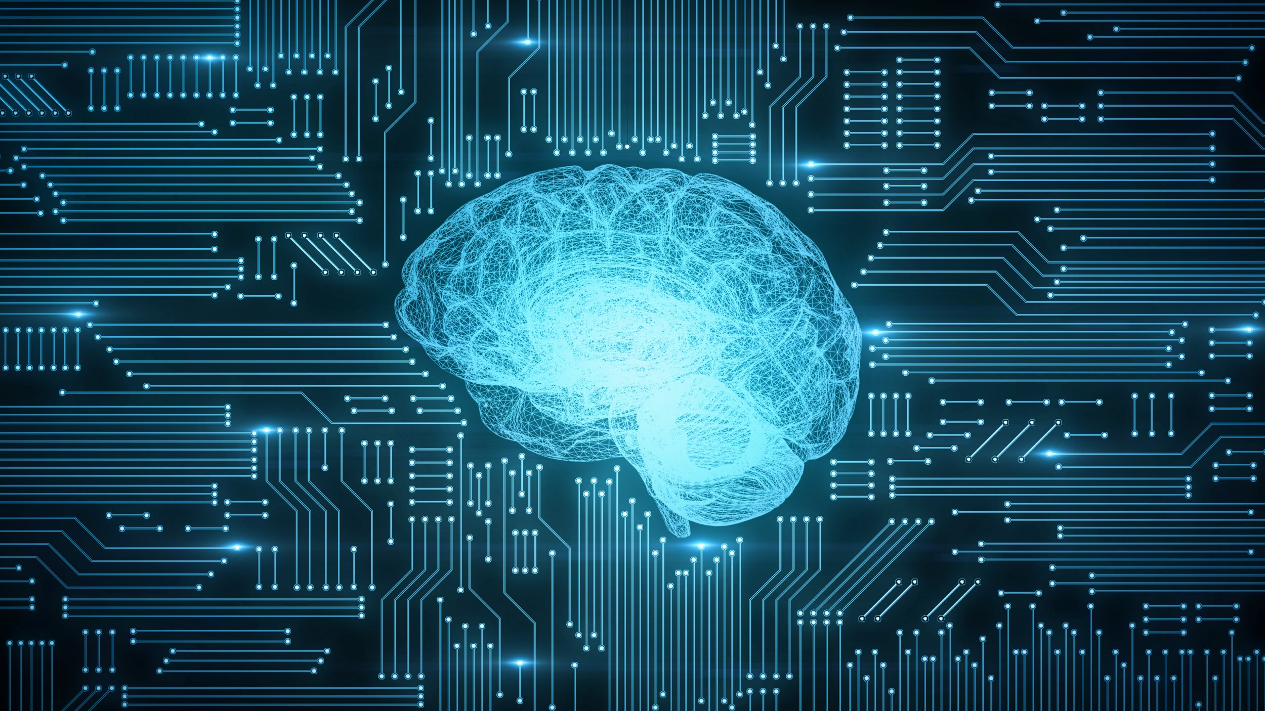
BRAIN FINGERPRINT
TECHNOLOGY

Slide 2
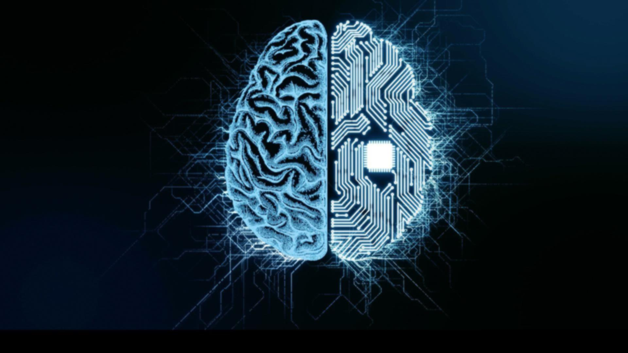
Group members :

Slide 3
Contents :
Introduction
Definition
Equipment and technology
Computer Controlled
Technique
Comparison with other technologies
Role in criminal proceedings
Applications
Advantages
Disadvantages
Conclusion

Slide 4
Introduction :
Brain fingerprinting is a scientific technique to determine whether or not specific information is
stored in an individual's
brain.
Brain fingerprinting was invented by Dr. Lawrence A. Farwell The chief scientist
and president of Human
Brain Research Laboratory, USA.
He had tested Brain Fingerprinting technology in over 170 cases. More than 80 of these were in real-life situations, and the rest were laboratory studies.

Slide 5
Definition :
"Brain fingerprinting" is a computer-based test that is designed to discover, document, and provide evidence of guilty
knowledge regarding crimes.
Brain fingerprinting is a technique that measures recognition of familiar stimuli by measuring electrical brain wave responses to words, phrases, or pictures that are presented on a computer screen .

Slide 6
Equipment and technology::
A personal computer.
A data acquisition
board.
Two monitors.
A EEG amplifier.
Software for data acquisition Some electrodes.

Slide 7
Computer controlled :
The electrodes to used to measure electrical brain activity.
The software presents
the stimuli, collects
the EEG data, and
analyzes the data.
Brain electrical activity amplified and stored on
a memory device.
During the data collection ,the stimuli are displayed to the subject on one monitor, and the investigator views another monitor.

Slide 8
Technique :
When someone commits a crime, his brain records it has a memory .
Brain Fingerprinting
seeks to reveal that
memory, by showing the suspect evidence taken
from the crime scene.
A head band with sensors
is placed on the subject.
A series of pictures or
words is flashed on the screen.
The computer records the brain waves produced in response to what the subject sees.

Slide 9
Application :
Test for several forms of employment, especially in dealing with sensitive military and foreign intelligence screening.
Individuals who were “information present” and “information absent”.
To detect symptoms of Alzheimers disease, Mental Depression and other forms of dementia including neurological disorders.
Criminal cases.
Counter-Terrorism.
Security Testing.

Slide 10
Electroencephalography:
Electroencephalography (EEG) is the measurement of electrical activity produced by the brain as recorded from electrodes placed on the scalp.
So-called scalp EEG is collected from tens to hundreds of electrodes positioned on different locations at the surface of the head.
EEG signals (in the range of mille-volts) are amplified and digitalized for later processing.
The data measured by the scalp EEG are used for clinical and research purposes.

Slide 11

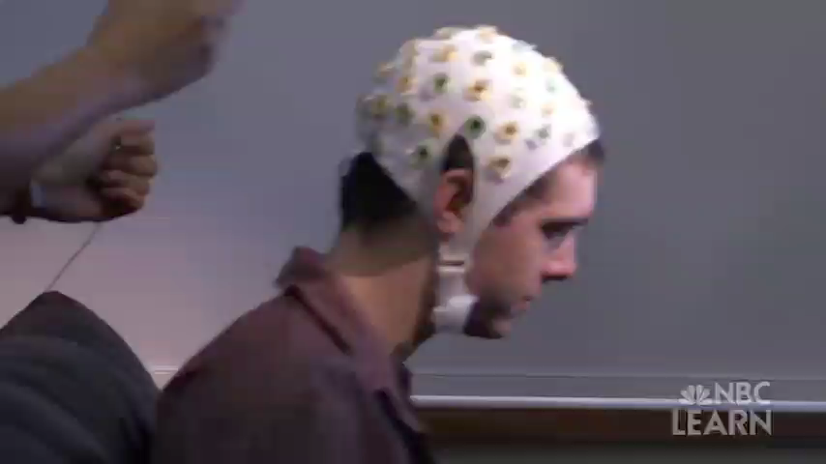
Here is a small application of this technique

Slide 12
Role In Criminal Proceedings:
The application of Brain Fingerprinting testing in a criminal case involves four phases:
Investigation
Interview
Scientific testing and
Adjudication.
The first phase is undertaken by a skilled investigator, the second by an interviewer who may be an investigator or a scientist, the third by a scientist, and the fourth by a judge and jury.

Slide 13
PHASE 1:
Investigation Before a brain fingerprinting testing can be applied, an investigation must be undertaken to discover information that can be used in the test.
PHASE 2:
Interview of Subject Once evidence has been accumulated through investigation, the interview with the suspect may help to determine which scientific tests to conduct, or how to conduct the tests.

Slide 14
PHASE 3: Scientific Testing with Brain Fingerprinting The input for this scientific procedure is the probe stimuli, which are formulated on the basis of the investigation and the interview. The output of this scientific procedure is a determination of “information present” or “information absent” for those specific probe stimuli.
PHASE 4: Adjudication of Guilt or Innocence The adjudication of guilt or innocence is the exclusive domain of the judge and jury. Science provides evidence, but a judge and jury must weigh the evidence and decide the verdict.

Slide 15
Comparison with other technologies :
The novel interpretation in brain fingerprinting is to look for P300 as response to stimuli related to the crime in question e.g., a murder weapon or a victims face. Because it is based on EEG signals, the system does not require the testee to issue verbal responses to questions or stimuli.
Brain fingerprinting uses cognitive brain responses, brain finger printing does not depend on the emotions of the subject, nor is it affected by emotional responses.
Brain fingerprinting is fundamentally different from the polygraph (lie-detector), which measures emotion-based physiological signals such as heart rate, sweating, and blood pressure.
Also, unlike polygraph testing, it does not attempt to determine whether or not the subject is lying or telling the truth.

Slide 16
Advantage :
The rate of error is extremely low virtually nonexistent and clear standards governing.
Record of 100% accuracy.
Identifies the criminal quickly and scientifically.
Provides immediate scientific result.
Reduced costs and complexities.
Support the right to a speedy and fair trail.
Disadvantage :
Not applicable for general screening.
It does not indicate intent of the crime.
Takes a fair amount of time to set up and conduct properly .
Difficult to distinguish the criminal and a witness who saw all the criminal activity happen

Slide 17
Conclusion :
Brain Fingerprinting is a revolutionary new scientific technology for solving The technology fulfills an urgent need crimes, identifying perpetrators, and for governments, law enforcement exonerating innocent suspects, with a agencies, corporations, investigators, record of 100% accuracy in research crime victims, and falsely accused, with US government agencies, actual innocent suspects. criminal cases, and other applications.

Slide 18
References :

Slide 19
THANK
YOU …

